Slide 1
Subject Title : Optimization Techniques Subject Code : 6CS1026 Title : Smart Logistics – Vehicle Routing Optimization
Team Members
Suriya.S.M-2023BCSE07AED028
Lakshin.S.K-2023BCSE07AED028
Pavan.M-2023BCSE07AED123

Slide 2
ABSTRACT
• Vehicle Routing Problem (VRP) is a critical optimization challenge in smart logistics.
• Objective is to find optimal delivery routes for multiple vehicles.
• Minimizes distance, fuel cost, delay, and operational expenses.
• Implemented algorithms: GA, PSO, ACO.
• Compared performance using MATLAB.
• Achieved near-optimal multi-vehicle routing solutions.

Slide 3
OBJECTIVE
• To solve the Vehicle Routing Problem for smart city logistics
• To implement GA, PSO, and ACO optimization algorithms
• To minimize total distance, fuel cost, delay, and operational expenses
• To compare efficiency of different optimization techniques
• To obtain cost-efficient delivery routes for multiple vehicles

Slide 4
PROBLEM STATEMENT
• Multiple vehicles must deliver goods to various customer locations
• All routes start and end at a central depot
• Vehicle capacity constraints must be respected
• Number of possible route combinations grows exponentially
• Exact methods become computationally infeasible for large instances
• Need efficient metaheuristic optimization techniques
• Must minimize: distance + fuel cost + delay + operational cost

Slide 5
INTRODUCTION
• VRP is widely studied in operations research and logistics
• Critical for smart city delivery and supply chain management
• Applications:
- Last-mile delivery optimization
- Fleet management and scheduling
- Supply chain and warehouse logistics
- Emergency vehicle routing
• Optimization reduces cost, emissions, and delivery time

Slide 6
TECHNIQUE 1 – GENETIC ALGORITHM (GA)
• Inspired by natural selection and genetics
• Population of route solutions evolves over generations
• Fitness function evaluates total cost (distance + fuel + delay + ops)
• Selection, crossover, and mutation operators
• Mutation swaps customers between vehicle routes
• Advantage: Good global search, stable convergence
• Limitation: Slower convergence compared to swarm methods

Slide 7
TECHNIQUE 2 – PARTICLE SWARM OPTIMIZATION (PSO)
• Inspired by bird flocking and fish schooling behavior
• Each particle represents a candidate routing solution
• Guided by personal best (pbest) and global best (gbest)
• Swap-based velocity for discrete VRP
• Balances exploration and exploitation
• Advantage: Fast convergence
• Limitation: May converge to local optima

Slide 8
TECHNIQUE 3 – ANT COLONY OPTIMIZATION (ACO)
• Inspired by ant foraging behavior
• Ants build routes using pheromone trails and heuristic info
• Shorter, cost-efficient routes get more pheromone
• Natural capacity-based route splitting for multi-vehicle
• Evaporation prevents premature convergence
• Advantage: High solution quality, best for VRP
• Limitation: Higher computation time

Slide 9
DATASET & SETUP
• 20 customer locations with random 2D coordinates
• 1 central depot for all vehicles
• 3 vehicles with capacity constraint of 100 units
• Customer demands: 5–20 units each
• Distance calculated using Euclidean formula
• Cost function: distance + fuel cost + delay penalty + vehicle fixed cost
• Fuel rate: 0.5 per unit distance
• Delay penalty: 2.0 per unit delay
• Fixed vehicle cost: 50 per vehicle deployed

Slide 10
EVALUATION METRICS
• Total Distance (sum of all vehicle routes)
• Fuel Cost (proportional to distance traveled)
• Delivery Delay (penalty for late arrivals)
• Operational Expenses (fixed cost per vehicle)
• Total Combined Cost (fitness value)
• Convergence Speed (iterations to reach near-optimal)
• Solution Consistency (variance across multiple runs)

Slide 11
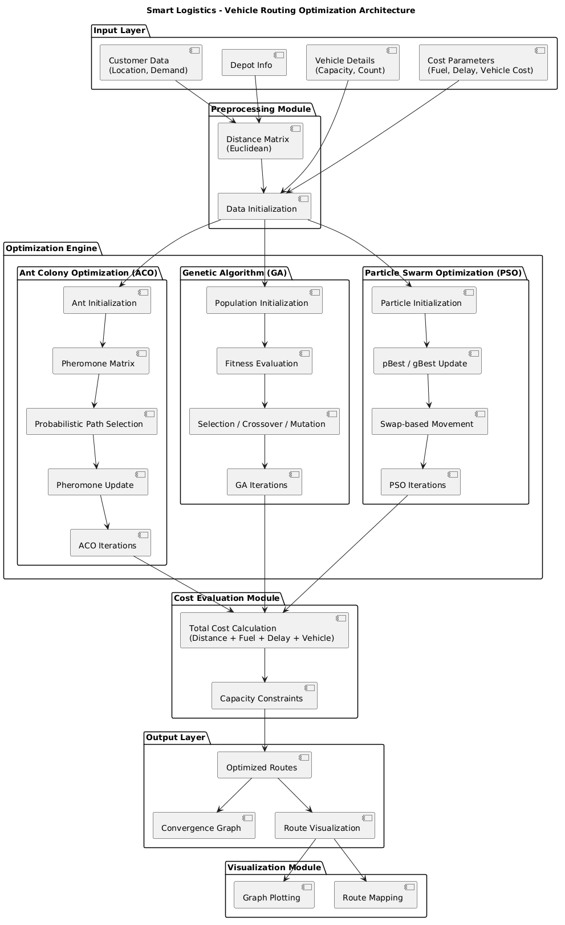
ARCHITECTURE DIAGRAM

Slide 12
RESULTS
• All three algorithms successfully reduce total delivery cost
• Convergence observed in cost vs. iteration graphs
• ACO achieves the lowest total cost overall
• PSO converges fastest among the three algorithms
• GA provides most consistent results across multiple runs
• All algorithms outperform random and greedy baselines

Slide 13
COMPARISON
Metric | GA | PSO | ACO
Solution Quality | Good | Good | Best
Convergence Speed | Moderate | Fastest | Moderate
Consistency | Most Consistent | Variable | Consistent
Computation Time | Moderate | Low | High

Slide 14
CONCLUSION
• Metaheuristic techniques effectively solve Vehicle Routing Problem
• Genetic Algorithm provides stable and reliable multi-vehicle solutions
• Particle Swarm Optimization shows fastest convergence
• Ant Colony Optimization gives the best and most cost-efficient results
• ACO is naturally suited for multi-vehicle routing with capacity constraints
• Swarm intelligence methods perform better overall for VRP
• These techniques are applicable to real-world smart city logistics
• Can reduce emissions, lower costs, and improve delivery service quality

Slide 15
REFERENCES
• G. B. Dantzig and J. H. Ramser, "The Truck Dispatching Problem," Management Science, 1959.
• M. Dorigo and L. M. Gambardella, "Ant Colony System," IEEE Trans. Evol. Comput., 1997.
• J. Kennedy and R. Eberhart, "Particle Swarm Optimization," IEEE, 1995.
• J. H. Holland, Adaptation in Natural Systems, 1975.
• D. E. Goldberg, Genetic Algorithms, 1989.
• P. Toth and D. Vigo, The Vehicle Routing Problem, SIAM, 2002.
• MATLAB Documentation, MathWorks.

Slide 16
THANK YOU

